Slide 1
Sets

Slide 2
Sets are unordered collections of unique elements.
Meaning there can only be one representative of the same object.
Let’s see some examples!

Slide 3
How many unique sports do people play in your oﬃce?

Slide 4



How many unique sports do people play in your oﬃce?

Slide 5
How many unique sports do people play in your oﬃce?
Soccer, Tennis
Cricket, Soccer
Golf...

Slide 6
How many unique sports do people play in your oﬃce?
Soccer, Tennis
Cricket, Soccer
Golf...
List_of_sports = [“Soccer”, “Tennis”, “Cricket”, “Soccer”, “Golf”]

Slide 7
How many unique sports do people play in your oﬃce?
Soccer, Tennis
Cricket, Soccer
Golf...
List_of_sports = [“Soccer”, “Tennis”, “Cricket”, “Soccer”, “Golf”]
Set_of_unique_sports = {“Soccer”, “Tennis”, “Cricket”, “Golf”}

Slide 8

What is a Set?

Slide 9
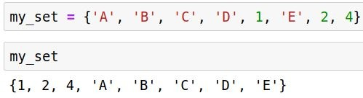
What is a Set?
Unordered collection of elements

Slide 10
What is a Set?
Unordered collection of elements
No duplicate element

Slide 11
What is a Set?
Unordered collection of elements
No duplicate element
Mutable or modiﬁable

Slide 12
What is a Set?
Unordered collection of elements
No duplicate element
Mutable or modiﬁable
Set theory operations are possible

Slide 13
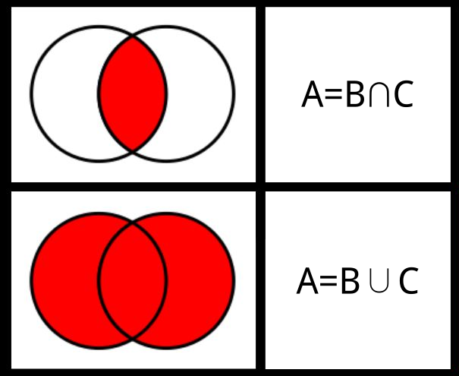
Set theory operations
Intersection of two sets:
set1.intersection(set2)
● Union of two sets:
○ set1.union(set2)
● Subsets etc..

Slide 14
Set theory operations
Intersection of two sets:
set1.intersection(set2)
Union of two sets:
set1.union(set2)
● Subsets etc..

Slide 15
Set theory operations
Intersection of two sets:
set1.intersection(set2)
Union of two sets:
set1.union(set2)
Subsets etc..

